Slide 1

Diabetes Classification
Weekly Assignment 2
By: Newton AI Team

Slide 2
Bussiness and Data Understanding
1
Basic Information about Diabetes

Slide 3
Reason of This Project
Definition
Diabetes is a chronic, metabolic disease characterized by elevated levels of blood glucose (or blood sugar), which leads over time to serious damage to the heart, blood vessels, eyes, kidneys and nerves. The most common is type 2 diabetes, usually in adults, which occurs when the body becomes resistant to insulin or doesn't make enough insulin.
Diabetes Risk
In the past 3 decades the prevalence of type 2 diabetes has risen dramatically in countries of all income levels. Type 1 diabetes, once known as juvenile diabetes or insulin-dependent diabetes, is a chronic condition in which the pancreas produces little or no insulin by itself. For people living with diabetes, access to affordable treatment, including insulin, is critical to their survival. There is a globally agreed target to halt the rise in diabetes and obesity by 2025.)
Key Point: An AI system for self-checking diabetes is needed to prevent someone from getting diabetes

Slide 4
Data Cleaning and Analysis
2
Correlation, Removing Outlier, and so on

Slide 5
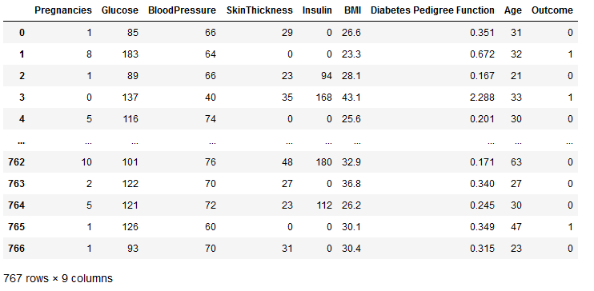
Exploring Datasets
Our Datasets has 767 data with total of 8 feature and 1 result.

Slide 6
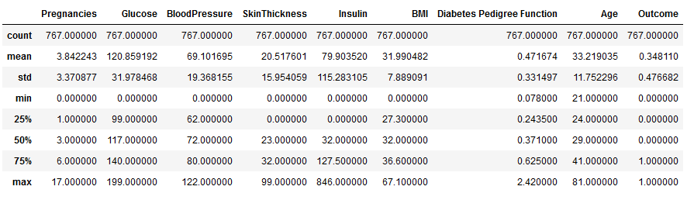
Exploring Datasets
Statistical component from the datasets.

Slide 7
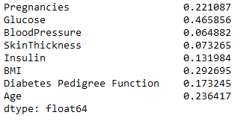
Exploring Datasets
Insight from Correlation:
We can assume that high glucose in their body has high risk getting diabetes
We can assume that person with high BMI has high risk getting diabetes

Slide 8
Data Modeling
3
Data modeling using MLP

Slide 9
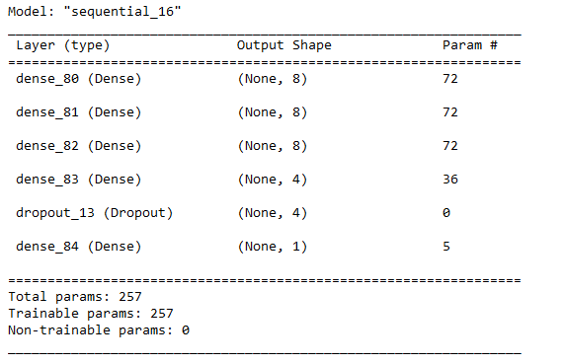
Data Modelling

Slide 10
Model Evaluation
4
Confusion Matrix Result

Slide 11
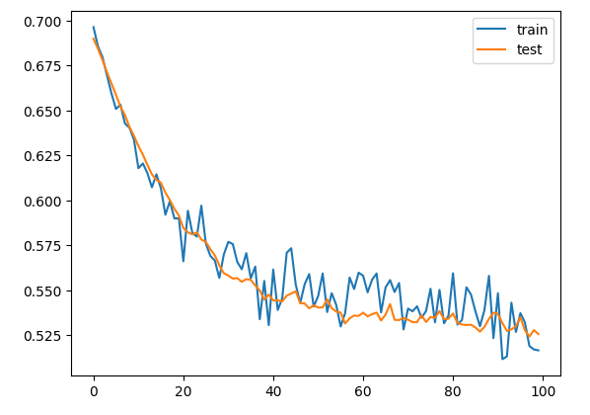
Data Modelling

Slide 12
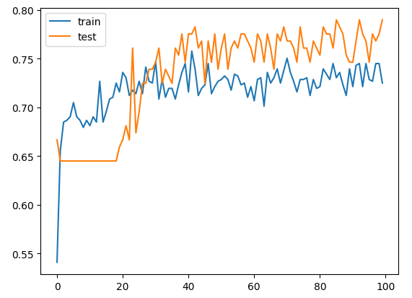
Data Modelling

Slide 13
Data Modelling

Slide 14
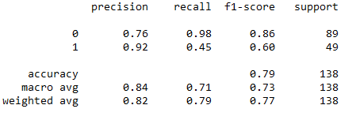
Data Modelling

Slide 15
Model Deployment
5
Website Result

